Slide 1
Health of a Nation
Global Data Visualisation
Sean Pei, Jia Na and Sumukh Kumble

Slide 2
Introduction
Global Data Visualisation
The health of a Nation is not a simple concept
Factors to measure a Nation’s health before 2020
Objective is to create a dashboard that provides data for different countries based on different parameters.
3 major dimensions: Agriculture, Environment and Citizen’s health
Sean Pei, Jia Na and Sumukh Kumble

Slide 3
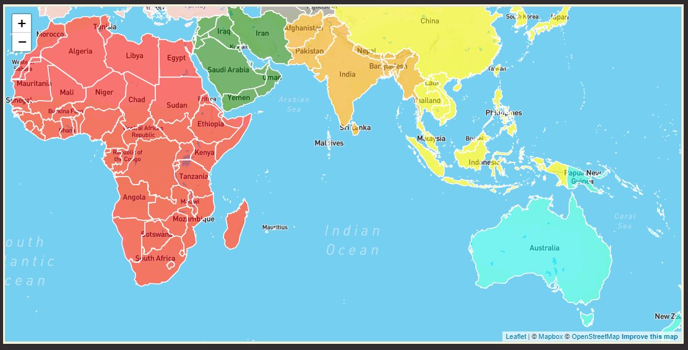
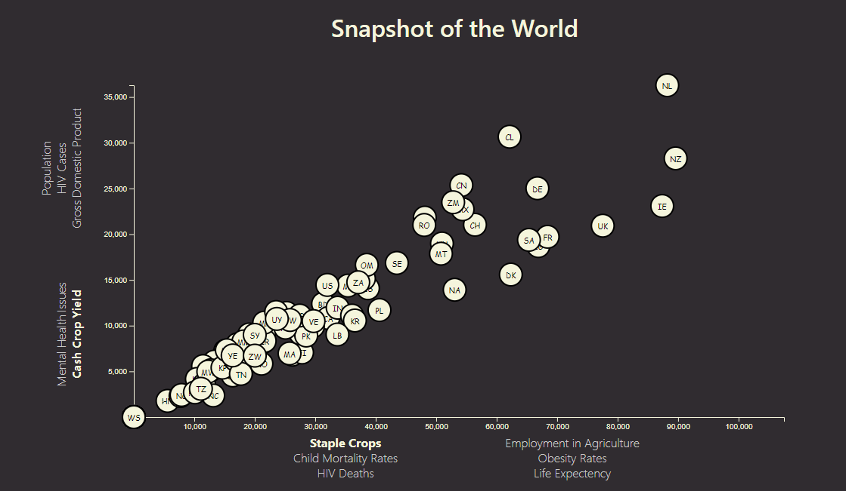
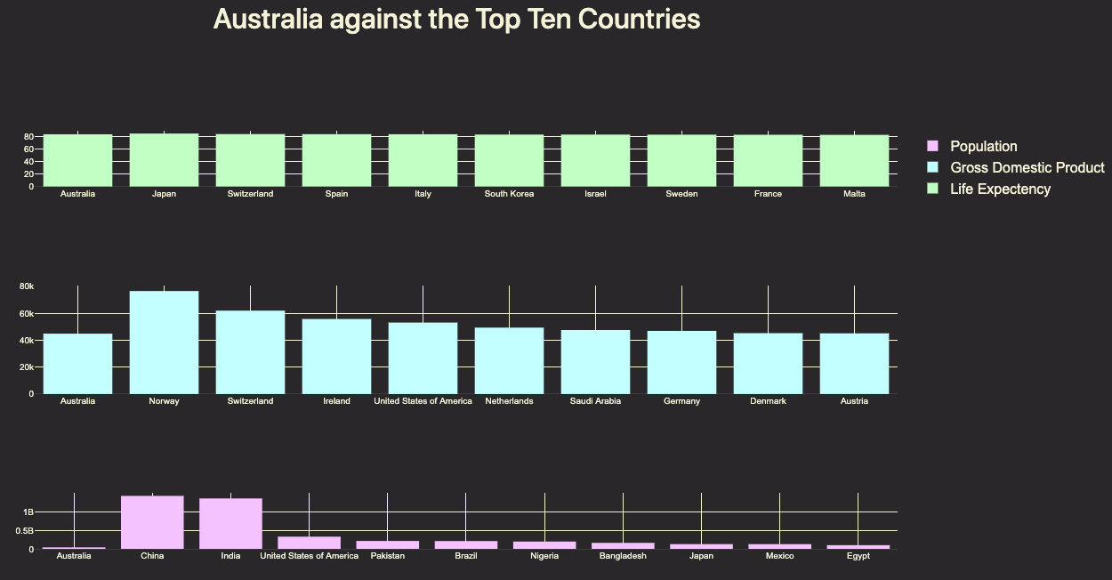
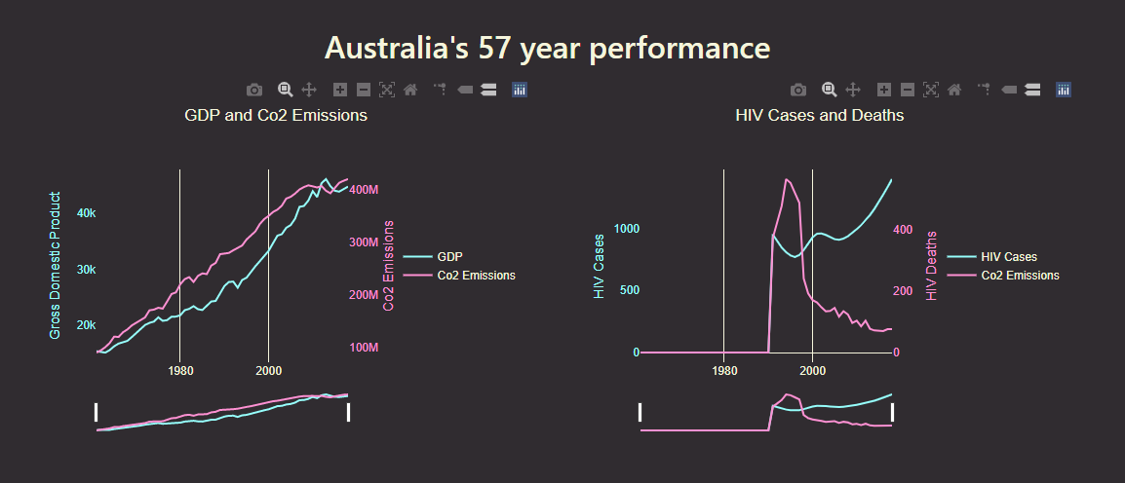
Design of the Web Dashboard
Global Data Visualisation
Geojson Data and Launched with Leaflet
D3 Library
Plotly JS
Plotly JS Interactive Timeseries
Sean Pei, Jia Na and Sumukh Kumble

Slide 4
Data Extraction, Translation and Loading
Global Data Visualisation
- Geojson Country Polygons
- Our world in data
- Food and Agriculture Organisation of the United Nations
Sean Pei, Jia Na and Sumukh Kumble

Slide 5
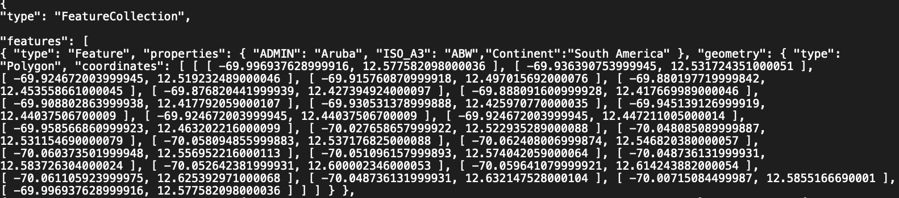
Geojson Country Polygons
Global Data Visualisation
Sean Pei, Jia Na and Sumukh Kumble

Slide 6
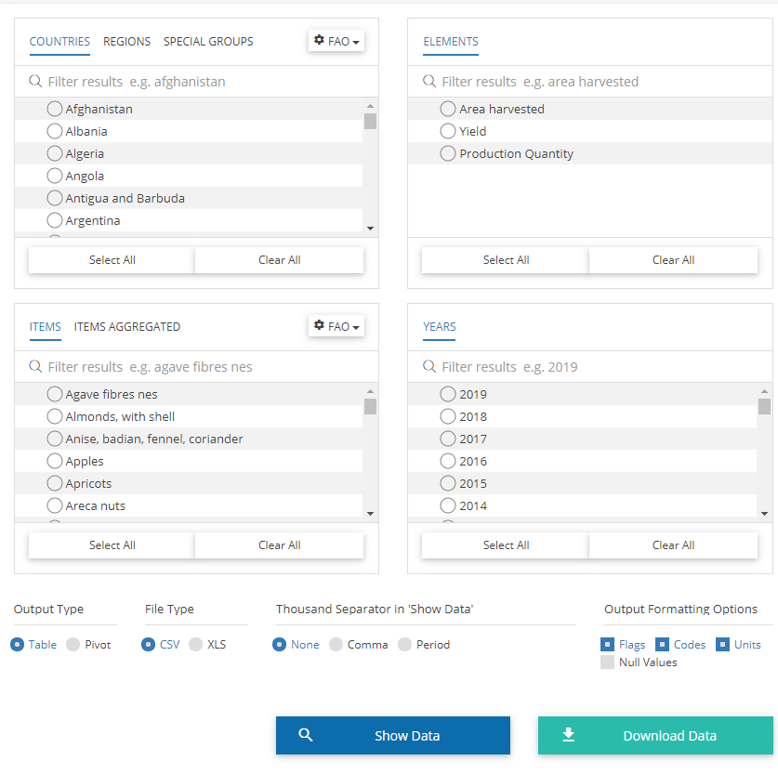
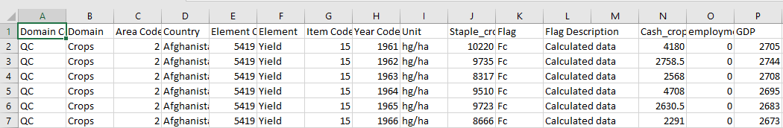


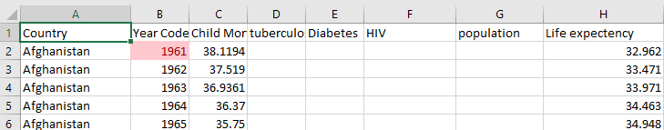
Our world in data & Food and Agriculture Organisation of the United Nations
Global Data Visualisation
Sean Pei, Jia Na and Sumukh Kumble

Slide 7
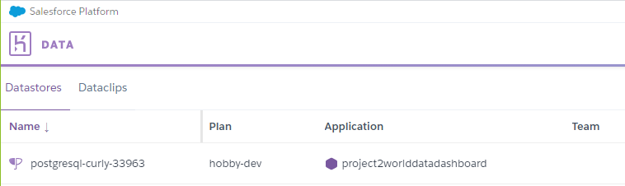
Cleaned Dataset
Global Data Visualisation
Sample
Sean Pei, Jia Na and Sumukh Kumble

Slide 8
Inspiration
Global Data Visualisation
How does agriculture and environment impact each other
Agriculture reports
Forecasting for Agriculture
..etc
Sean Pei, Jia Na and Sumukh Kumble

Slide 9
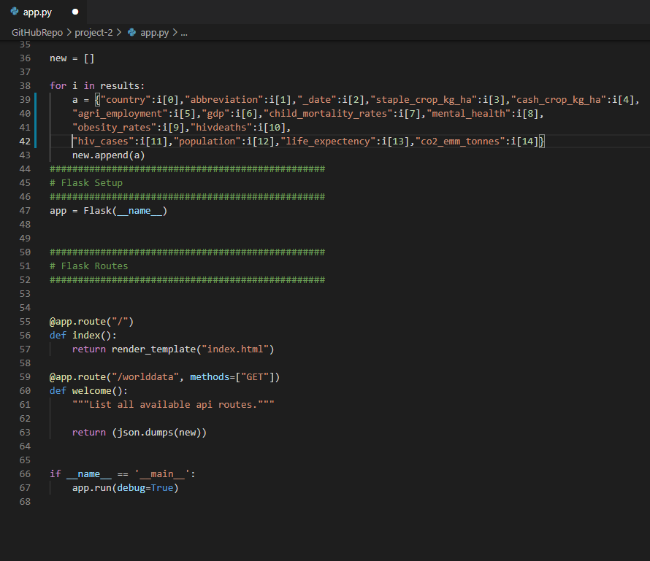
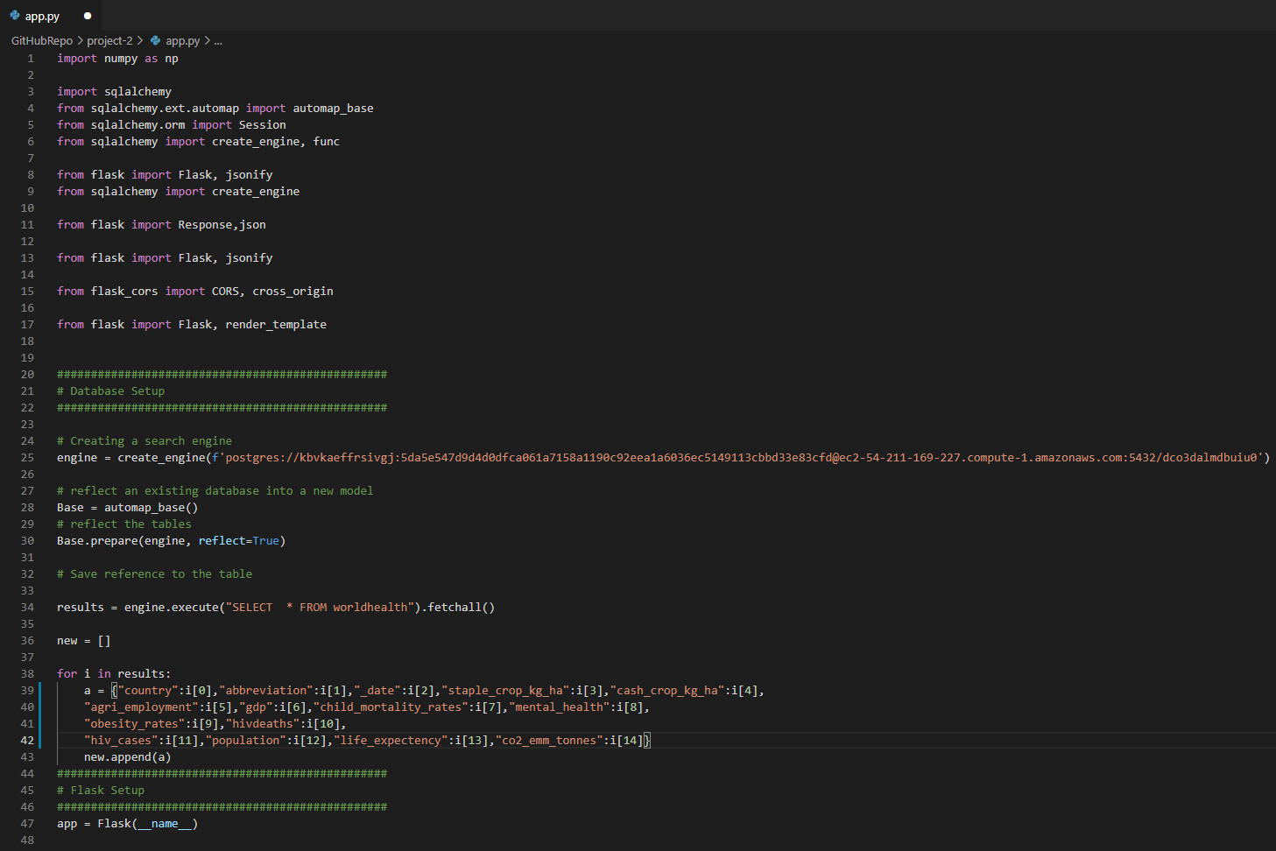
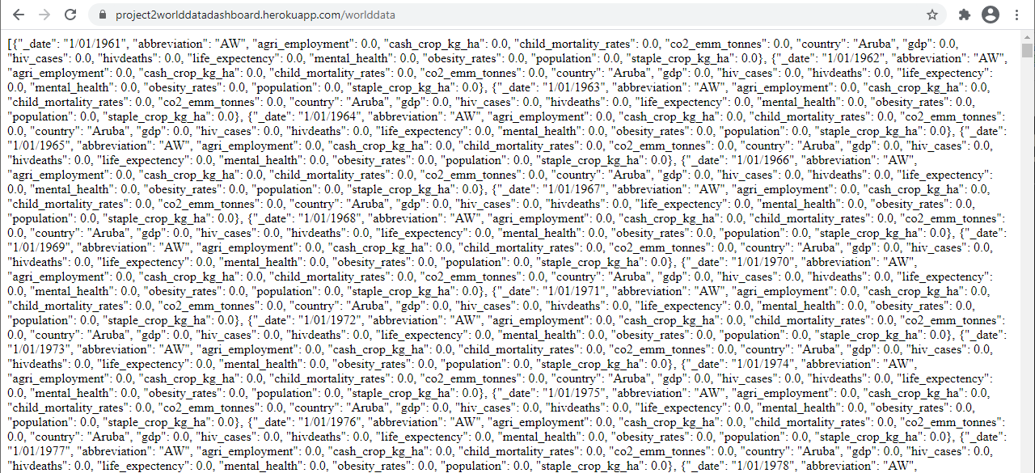
Languages and dependencies utilised
Global Data Visualisation
Language: Python
Dependencies:
- Flask
- SQL ALchemy
Cloud Server Accessed
Heroku
Language: PostgreSQL

Slide 10
HTML/CSS
Global Data Visualisation
Sean Pei, Jia Na and Sumukh Kumble

Slide 11
Project Demonstration
Global Data Visualisation
Sean Pei, Jia Na and Sumukh Kumble

Slide 12
Question Time?
Global Data Visualisation
Sean Pei, Jia Na and Sumukh Kumble

